Slide 1
STM Study of Mott Gap in TaS₂
Xin-Yang Zhu, Shao-Chun Li
March 2nd, 2018

Slide 2
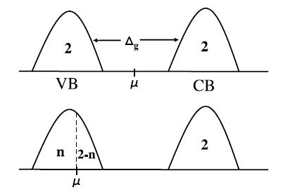
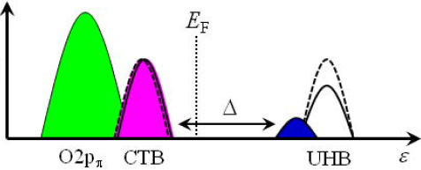
Three-band model v.s. one-band model?
Single-particle DOS in a Fermi liquid
as a function of the electron filling n
Three-band model
LHB

Slide 3
Research Background
Mottness Collapse in 1T-TaS_{2-x}Se_{x} Transition-Metal Dichalcogenide: An Interplay between Localized and Itinerant Orbitals
Shuang Qiao, …, Jian Wu, Yayu Wang, Zheng Liu, Phys Rev X 7, 041054 (2017)

Slide 4
Research Background
Mottness Collapse in 1T-TaS_{2-x}Se_{x} Transition-Metal Dichalcogenide: An Interplay between Localized and Itinerant Orbitals
Shuang Qiao, …, Jian Wu, Yayu Wang, Zheng Liu, Phys Rev X 7, 041054 (2017)

Slide 5
Research Background
Mottness Collapse in 1T-TaS_{2-x}Se_{x} Transition-Metal Dichalcogenide: An Interplay between Localized and Itinerant Orbitals
Shuang Qiao, …, Jian Wu, Yayu Wang, Zheng Liu, Phys Rev X 7, 041054 (2017)

Slide 6
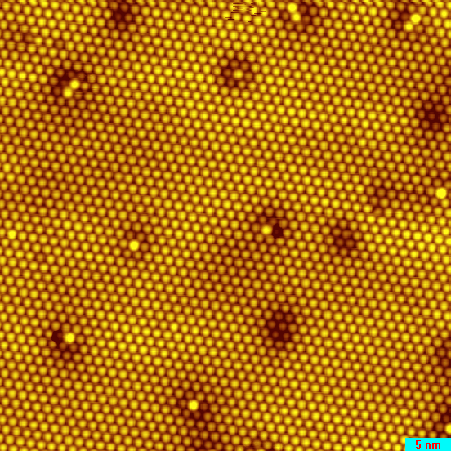
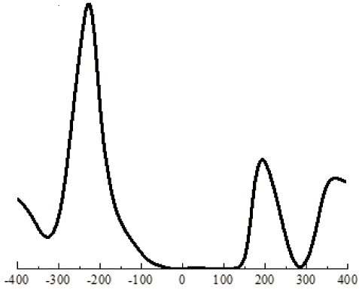
Clean Surface and STS
200mV 100pA 50X50nm
500mV 200pA

Slide 7
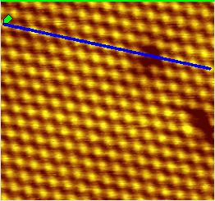

STS Line Map Taken at the Clean Surface
STS line map
1V, 200pA, modulation: 15mV

Slide 8
STS Taken at Surface Defects

Slide 9
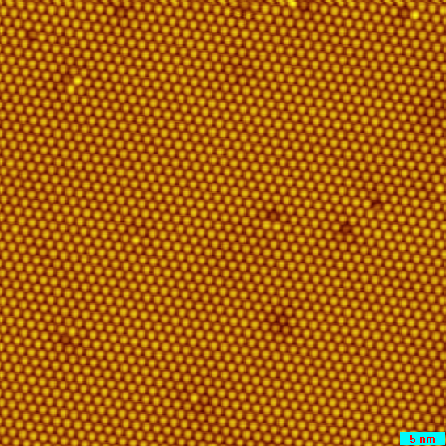
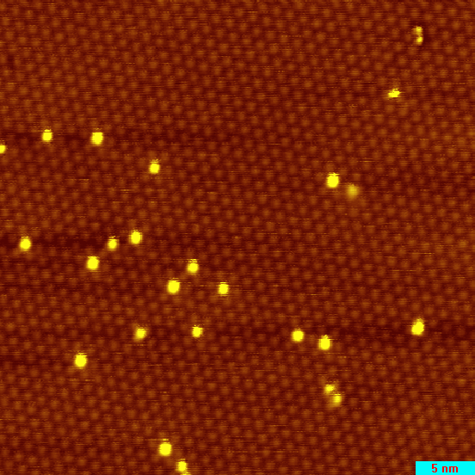
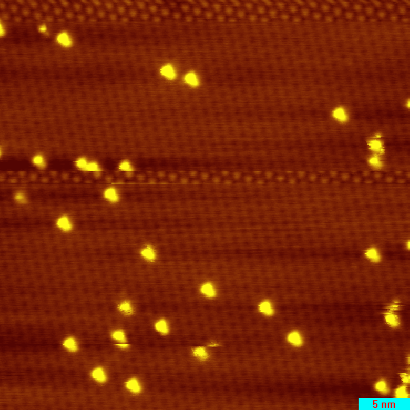
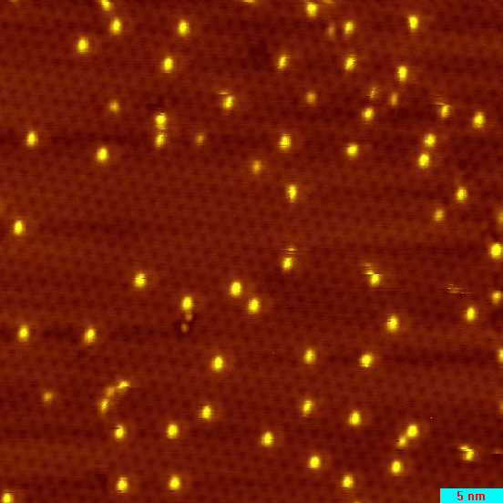
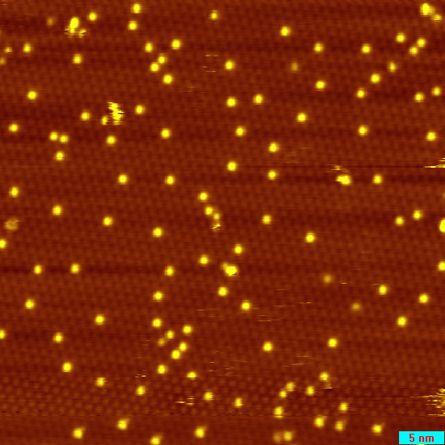
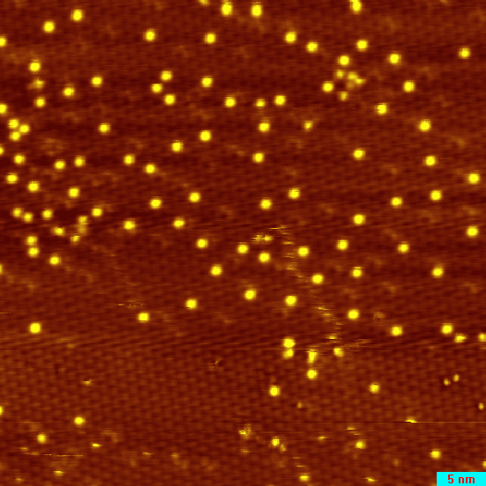
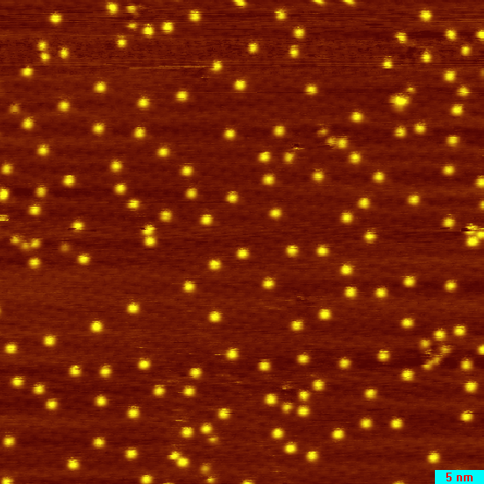
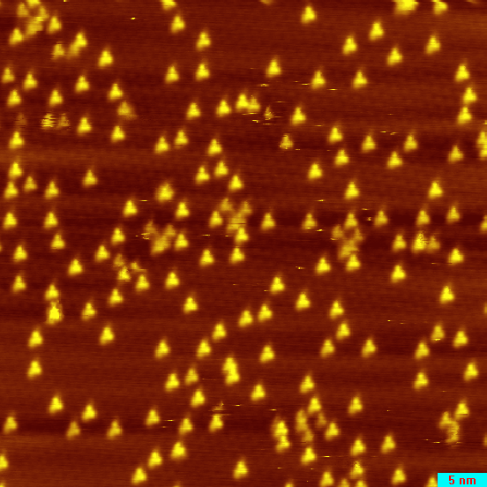
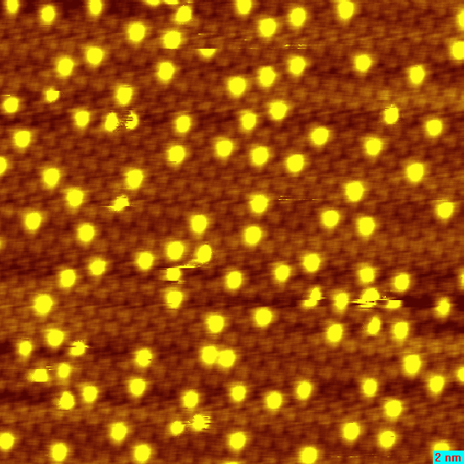
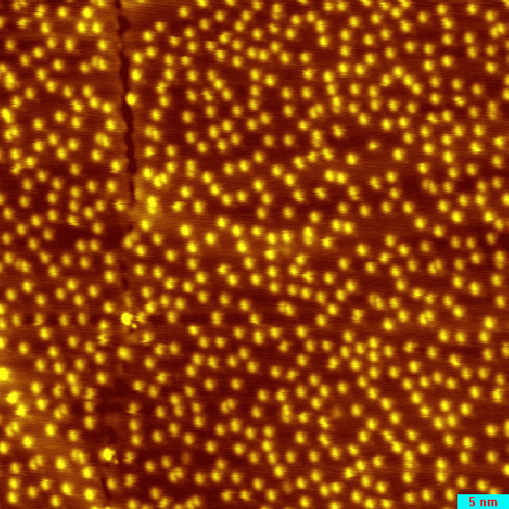
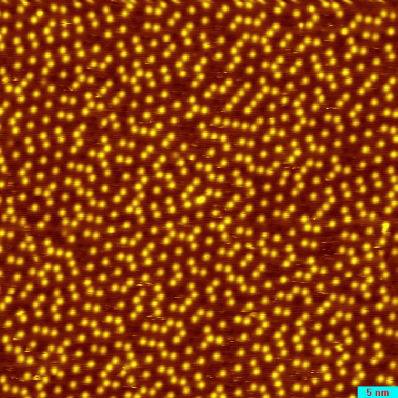
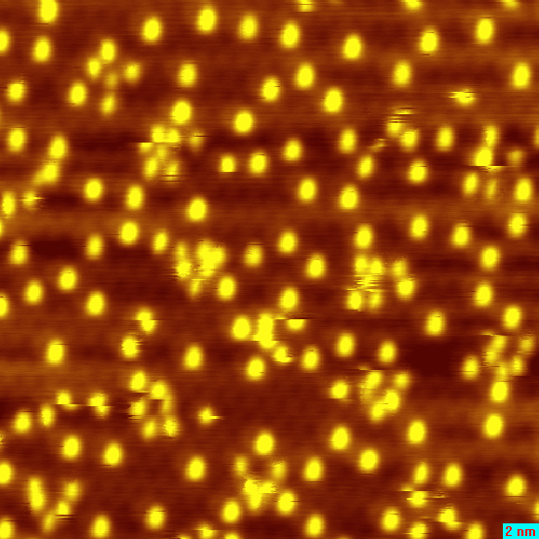
TaS₂ Surface with K Doping
0 ML
0.016 ML
0.02 ML
0.044 ML
0.047 ML
0.053 ML
0.065 ML
0.07 ML
0.12 ML
0.18 ML
0.24 ML
0.32 ML

Slide 10
STS Spectra with K Doping

Slide 11
Spectral Feature Evolution upon K Doping
?
?

Slide 12
Long-range Coherence of CDW
FFT
CDW
Filtered
IFFT

Slide 13
Long-range Coherence of CDW

Slide 14
Summary
随着电子的掺杂，费米能级开始向UHB移动，同时两个Hubbard带并没有明显的变化
当Fermi能级移动到上hubbard处时，能带突然发生变化，Mott gap消失，成为金属态
金属态依然具有长程的电荷密度波序
问题：

Slide 15
K: 17s
+ Pulse
K: 17s
K: 1s

Slide 16
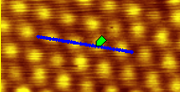
1V 100pA
100 X 100nm

